Slide 1




Data Structure
Linked Lists
Lecturer: Dr. Alaa Ahmed Abbood
Lecture 3.
Class 2nd .
Time: 12:30-2:30
Department: Businesses Information Technology (BIT)

Slide 2


Outline
Linked Lists.
Linked Lists definitions.
Operations On Singly Linked List.
Inserting at the beginning of the list
Inserting at the end of the list
Inserting after a given element.
Deleting from the beginning of the list.
Deleting from the end of the list.

Slide 3
Linked Lists
Previously, we presented the array data structure and discussed some of its applications. Arrays are easy and simple for storing things in a certain order, but they have drawbacks:-
They are not very adaptable. For instance, we have to fix the size n of an array in advance, which makes resizing an array difficult.
Insertions and deletions are difficult because elements need to be shifted around to make space for insertion or to fill empty positions after deletion. Therefore, we explore an important alternate implementation of sequence, known as the singly linked list.

Slide 4
Linked Lists
A linked list, in its simplest form, is a collection of nodes that together form a linear ordering. In a singly linked list each node is divided in two parts which are, first part contain information about element (info), and second part, called link field or next pointer field, contain the address of the next node in the list.
In addition, another pointer variable, for example head is used that contains the address of the first element of the list. The last element of the linked list (called tail) has NULL value in the nextpointer field as in the figure below.

Slide 5
Linked Lists
Linked lists can be thought of from a high level perspective as being a series of nodes. Each node has at least a single pointer to the next node, and in the last node’s case a null pointer representing that there are no more nodes in the linked list.

Slide 6
Operations On Singly Linked List
Inserting an element
To insert an element in the list, the first task is to get a free node, assign the element to be inserted to the info field of the node, and then new node is placed at the appropriate position by adjusting the appropriate pointer. The insertion in the list can take place at the following positions:
At the beginning of the list
At the end of the list
After a given element

Slide 7
Operations On Singly Linked List
Inserting at the beginning of the list
To insert an element at the beginning of the list, first we test whether the linked list is initially empty. If yes, then the element is inserted as the first and only element of the list by performing the following steps:
Assign Null value to the next pointer field of the new node.
Assign address of the new node to head.
However, if the list is initially not empty, then the element is inserted as the first element of the list by performing the following steps:
Assign value of the head variable to the next pointer field of the new node.
Assign address of the new node as in the figure (2) below.

Slide 8
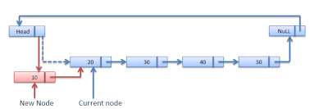
Operations On Singly Linked List
Inserting at the beginning of the list

Slide 9
Operations On Singly Linked List
Inserting at the end of the list
To insert an element at the end of the list, first we test whether the linked list is initially empty. If yes, then the element is inserted as the first and only element of the list by performing the following steps:
Assign Null value to the next pointer field of the new node.
Assign address of the new node to head.
However, if the list is initially not empty, then the element is inserted as the last element of the list by performing the following steps:
Assign Null value to the next pointer field of the new node.
Assign address of the new node to the next pointer of the last node as in the figure (3).

Slide 10
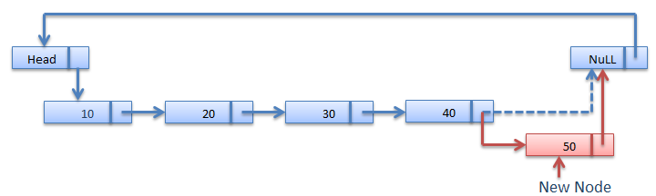
Operations On Singly Linked List
Inserting at the end of the list

Slide 11
Operations On Singly Linked List
Inserting after the given element of the linked list
To insert the new element after the given element, first we find the location (loc) of the given element in the list, and then the element is inserted in the list by performing the following steps:
Assign the next pointer field of the node pointed by loc to the next pointer field of the new node.
Assign address of the new node to the next pointer field of the node pointed by loc as in figure 4 below.

Slide 12
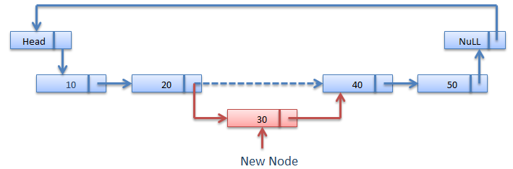
Operations On Singly Linked List
Inserting at the end of the list

Slide 13
Operations On Singly Linked List
Deleting an element from linked list
To delete an element from the list first the pointers are set properly and then the memory occupied by the node to be deleted is de-allocated (freed).
The deletion in the list can take place at the following positions:
At the beginning of the list.
At the end of the list.

Slide 14
Operations On Singly Linked List
Deleting from the beginning of the list
An element from the beginning of the list can be deleted by performing following steps:
Assign the value of head to a temporary variable temp.
Further, there are two cases:
If there is only one element in the existing list, both head and tail variable are set to NULL.
If there are more than one element in the list, then following steps given below:
Assign NULL value to the previous pointer field of the second node.
Assign address of the second node to head.
De-allocate the memory occupied by the node pointed to by temp figure 5 shows the deleting processes.

Slide 15
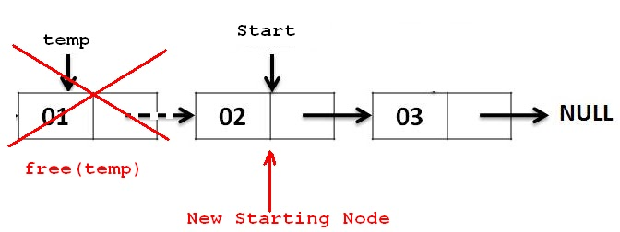
Operations On Singly Linked List
Deleting from the beginning of the list

Slide 16
Operations On Singly Linked List
Deleting from the end of the list
Deleting An element from the end of the list can be deleted by performing following steps:
Assign the value of tail to a temporary variable temp.
Further, there are two cases:
If there is only one element in the existing list, both head and tail variable are set to NULL.
If there are more than one element in the list, then following steps given below:
Assign NULL value to the next pointer field of the last node.
Assign address of the second last node to tail.
De-allocate the memory occupied by the node pointed to by temp figure 6 shows the deleting processes.

Slide 17
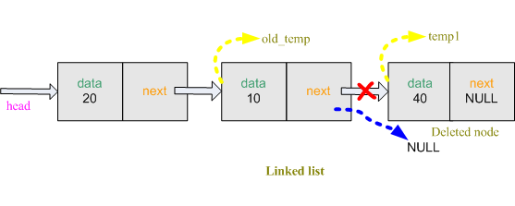
Operations On Singly Linked List
Deleting from the end of the list

Slide 18

THANK YOU

